Slide 1
Analysis summary: Canada
A Brief Analysis of the Canadian Economy
and its Investors

Slide 2
Introduction
This presentation will give you a snapshot of insights into Australia’s
Economy status, including
Debt level, financial assets level, wealth distribution, and
Its domestic investors’ investment behavioral preferences.

Slide 3
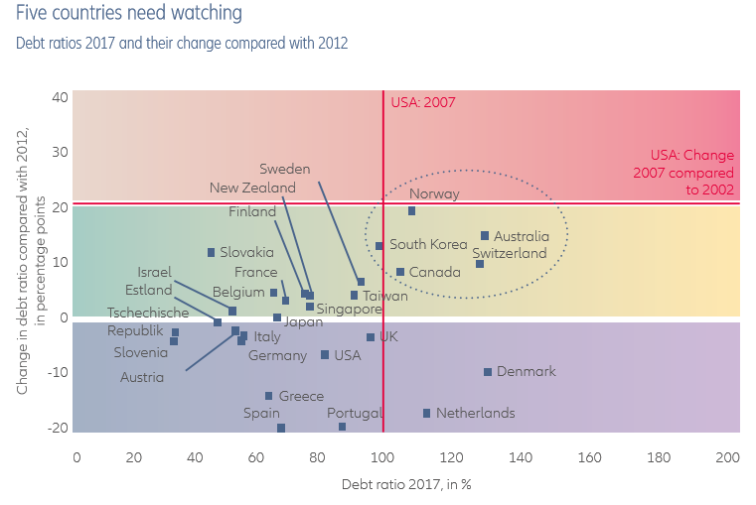
Debt Level
Though exceeding the safety benchmark, Canada’s debt level is not of the greatest concern for the country.
Safety benchmark:
Debt: GDP = 100%
Past 5-years growth: +20%
Canada:
Debt: GDP = 104.3%
Past 5-years growth: +9%

Slide 4
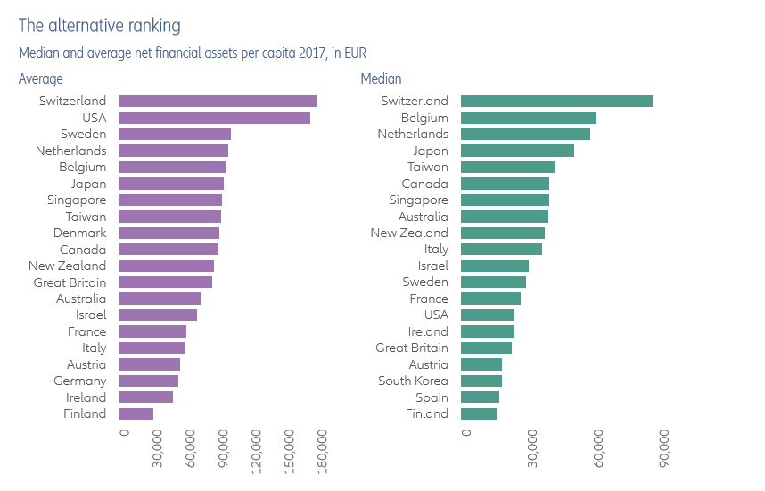
Wealth Distribution
If a country ranks high in average net financial assets but falls low on the median list, that means there is a pool of extremely rich population that is pulling the average high, whereas half or more of the population remains relatively poor.
Canada: 10th → 6th
Canada: 48% of assets held by the richest decile of the population
US: 77.1%
Industrialized countries: 51%
Canada’s wealth distribution is even in comparison to developed nations.

Slide 5
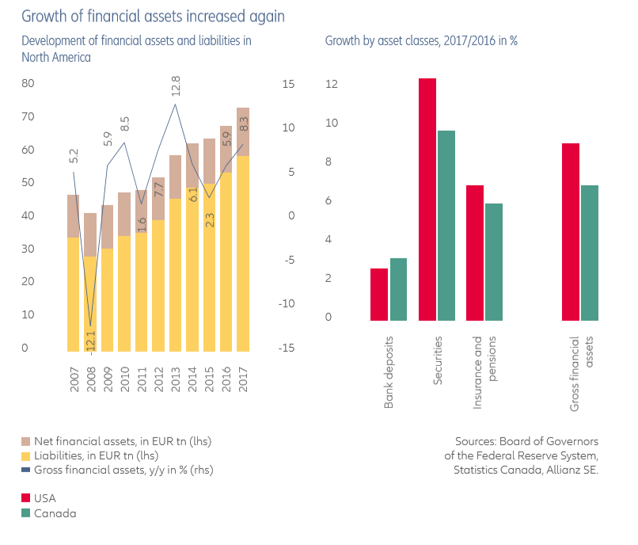
Financial Assets
Growth:
Canada: +6.5%
US: +8.5%
Industrialized avg: +6.5%
Only about 8% of Canada’s growth came from fresh funds; the bulk of the growth was due to changes in the value of the portfolio (+85% in the past decade)

Slide 6
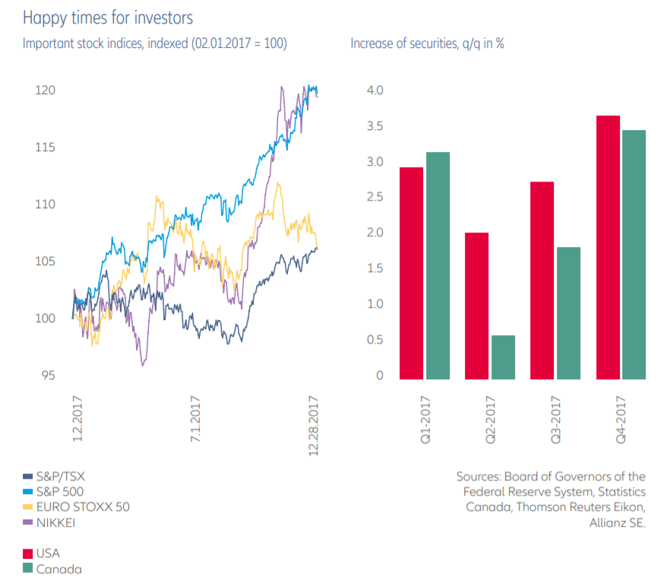
Investment Preferences
Canada’s benchmark index:
2016: 15280 points
2017: 16200 points
2019: 16488 points
This statistic can be compared to the US, which experienced a 9.1% increase in its index in 2017.

Slide 7
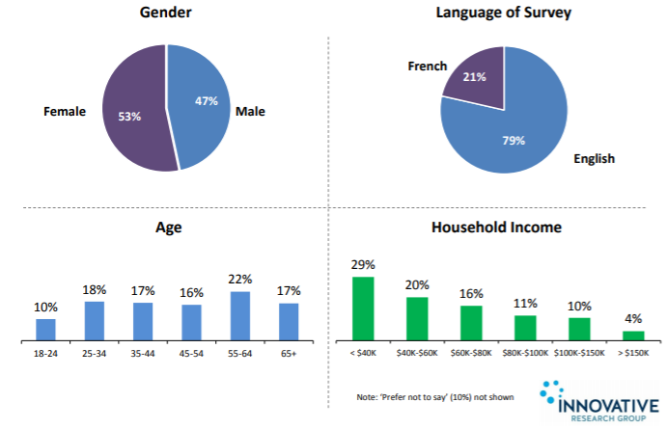
Investor Preferences
The following information is extracted from the 2017 CSA Investor Index Study:
The survey consists of:
7,271 Canadian respondents
Carefully selected to represent each demographic group and region.

Slide 8
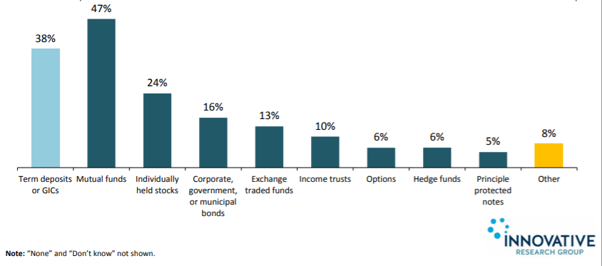
Investor Preferences
Mutual funds remain the most popular investment vehicles for Canadians.
Least favorite:
Options (6%)
Hedge fund (6%)
Principle Protected notes (5%)
Popular vehicles are the less riskier ones.

Slide 9
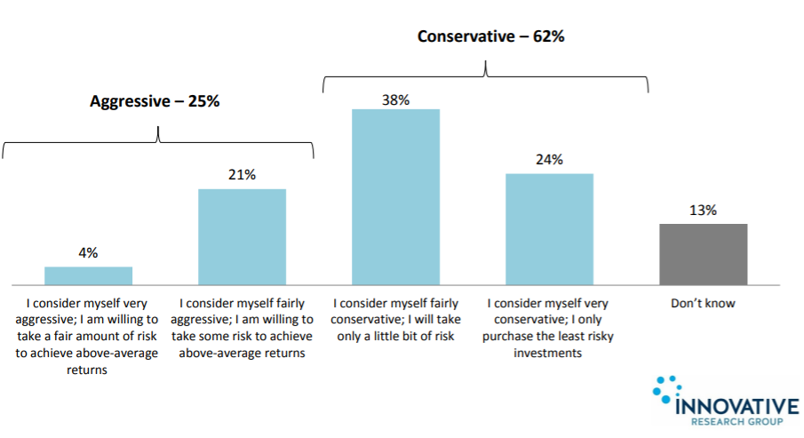
Investor Preferences
Canadians are generally more conservative/risk-averse.
Respondents are more than twice as likely to be conservative (62%) than aggressive (25%).

Slide 10
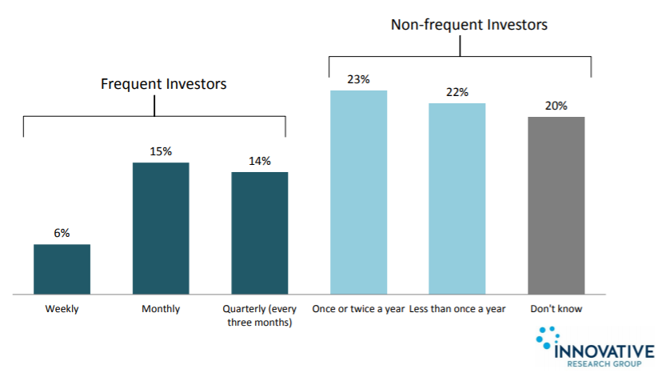
Investor Preferences
Most Canadians are non-frequent investors.
45% respondents invest once or twice a year at most.
21% (frequent investors) buy investments at least monthly.

Slide 11
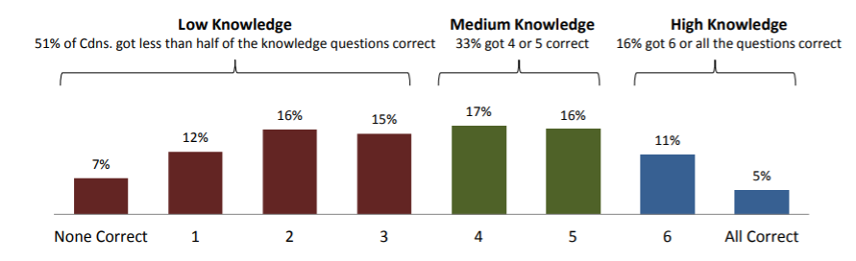
Investor Preferences
The test is consisted of seven questions that make up the Investment Knowledge Index, varying in areas such as simple compound interest, diversification, mutual fund returns and etc.
Canadians are not thoroughly educated for investments.
50% respondents answered 3/6 basic investment questions correctly at most.

Slide 12
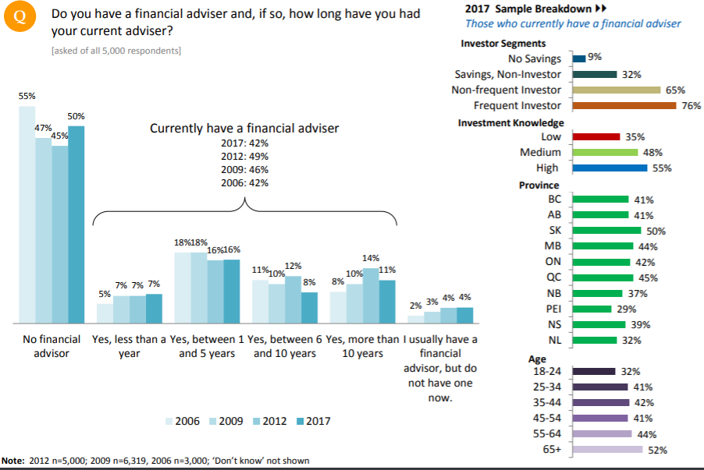
Investor Preferences
The lack of investment knowledge may be why Canadians are comfortable with investment advisors.
4-in-10 (42%) Canadians have a financial adviser.
However, that number is continuously decreasing over the past decades.

Slide 13
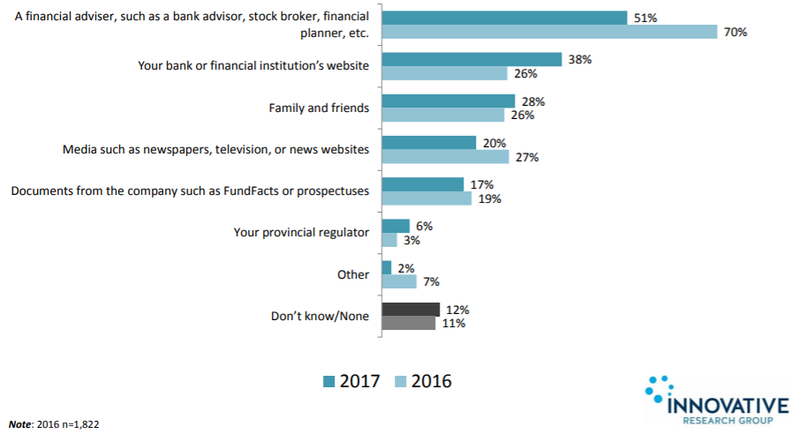
Investor Preferences
But, financial adviser (bank advisor/broker) remain the most common source of information used by Canadian investors.
The least common sources are provincial regulator or reading company documents (i.e. prospectus).

Slide 14
Thank you for your time

Slide 15
Sources used:
https://www.allianz.com/content/dam/onemarketing/azcom/Allianz_com/migration/media/economic_research/publications/specials/en/Allianz_Global_Wealth_Report_2018_e.pdf
https://www.securities-administrators.ca/uploadedFiles/Investor_Tools/CSA07%20Investor%20Index%20Deck%20-%20Full%20Report%20-%2020171128.pdf
For detailed information and explanation, please refer to the word document version of this analysis summary presentation.

